Slide 1

Multi Modal Intelligent Traffic Control in a Connected Vehicle Environment
Niraj Vasant Altekar
May 17, 2019

Slide 2
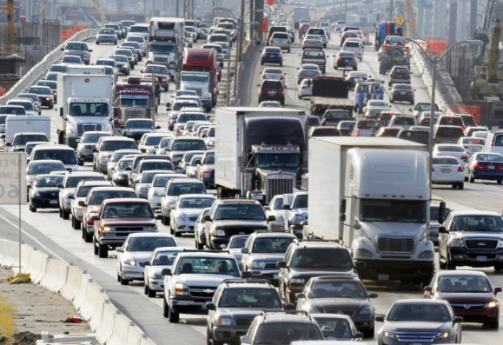
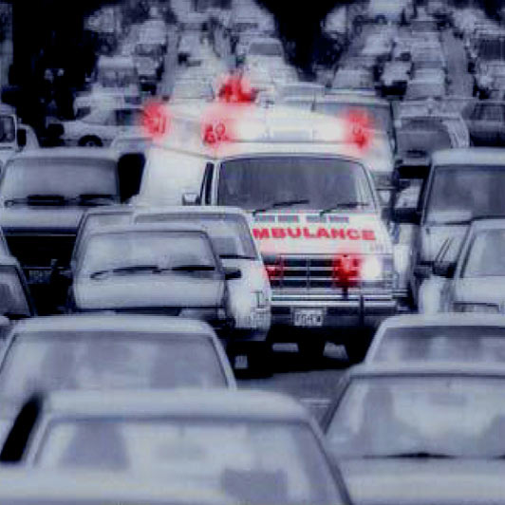
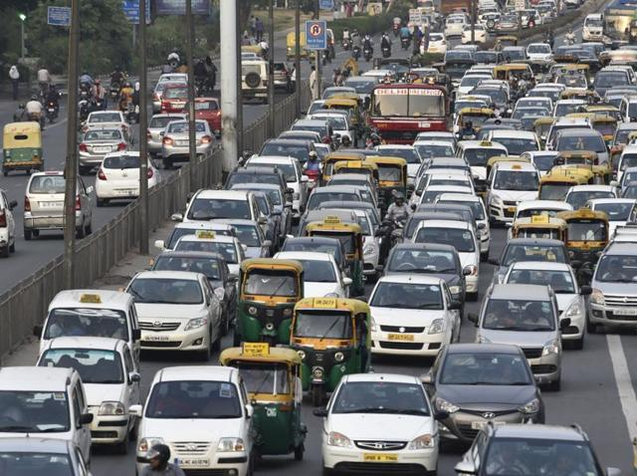
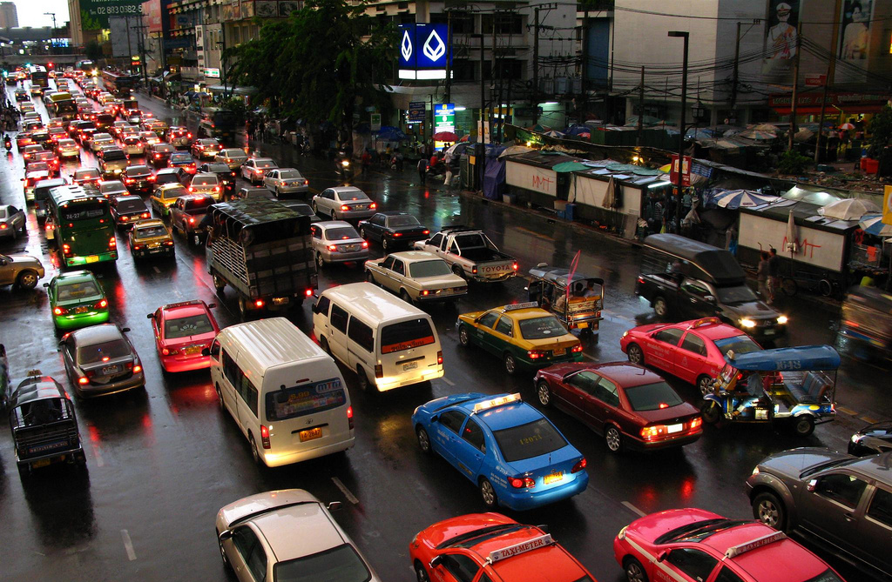
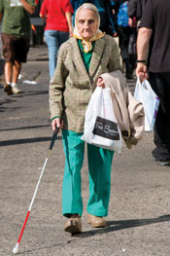
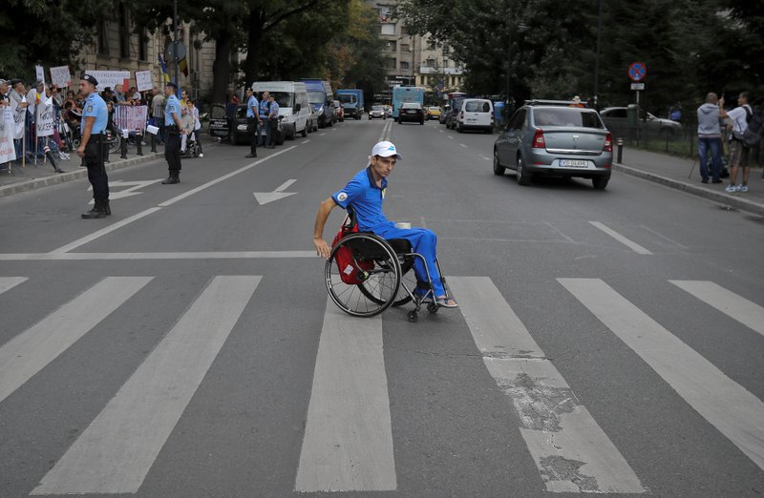

Slide 3
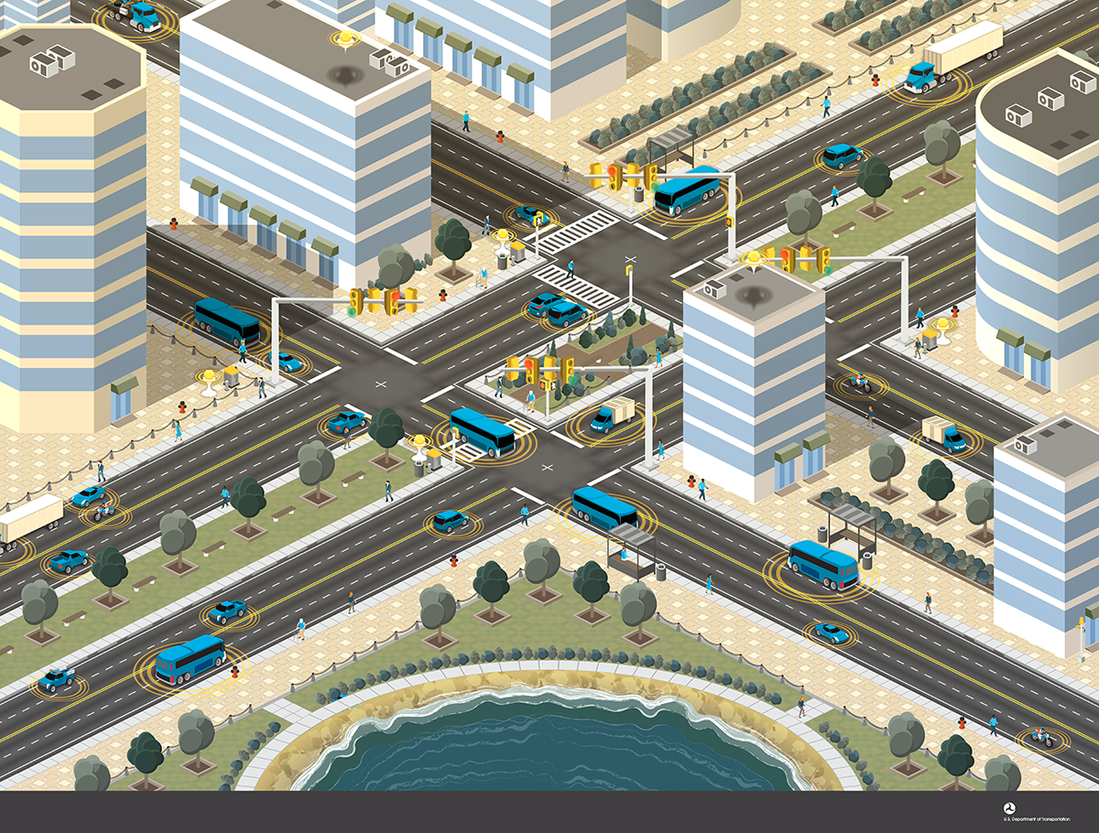
Prioritization of Emergency vehicles
Transit/Freight vehicles leveraging signal priority
Interconnected Pedestrians Mobility Application - Disabled pedestrians make their way safely through intersections
Advanced traffic signal controls based on traffic flow
Data collected from connected vehicles provide insights into the performance of the intersection

Slide 4
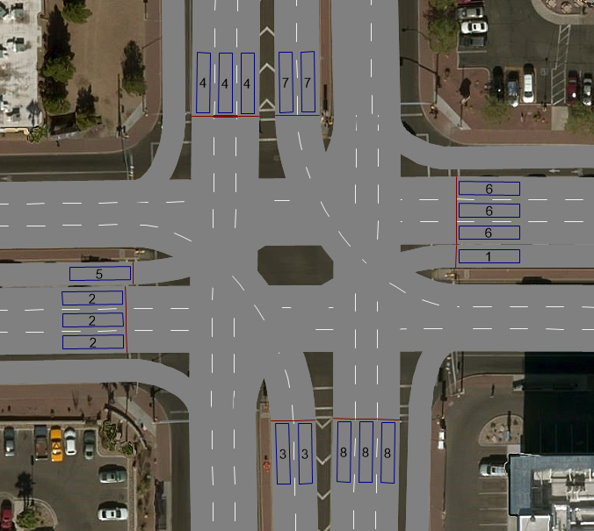
Road Intersection Terminology
1
2
Phase Numbering
NEMA Conventions
Odd: Left Turn Movements
Even: Through Movements
Clockwise 3-8-1-6-7-4-5-2
Approach Numbering
Odd: Ingress
Even: Egress
Anticlockwise 1-2-3-4-5-6-7-8
8
3
7
4
Vehicle Detectors
Signal Heads
6
5
#
Approach

Slide 5
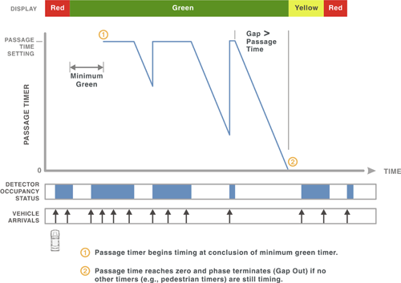
Signal Control
Fixed Time Signal Control
Signal times are predetermined for all phases
May have different timing plans for different time of the day to accommodate traffic volume variations
Traffic Actuated Signal Control
Signal times are determined based on traffic demand in real-time.
3 Important time values:
Minimum Green (Gmin)
Vehicle Extension (Ext) or Passage Time
Maximum Green (Gmax)
When a vehicle is detected, a call for green is placed for a phase. Signal remains green for minimum green time.
Green time is extended to accommodate the demand until maximum green time is reached.
Criteria for phase termination (end of green time)
Gap out : No more vehicles detected within the Vehicle extension time
Max out : Maximum green time reached

Slide 6
Ring Barrier Logic
Barrier
1 | 2 | 3 | 4
5 | 6 | 7 | 8
Ring-1
Ring-2
Time

Slide 7
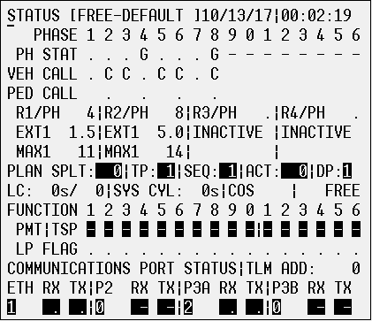
Signal Controller - Interface
Simulation Time
Phase Current Status
Vehicle Calls
Gmin or Ext Timer
Serving Phases
Max Green

Slide 8
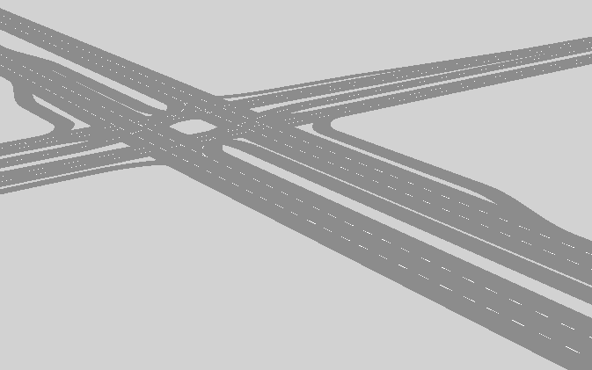
System Simulation – Basic System
Simulation Resolution: 10 Real Time steps/Simulation Second
Normal Traffic Actuated Signal System
Trucks enters the network at 00:01:50 (Simulation time), and enters the visible section at 00:01:57.
Truck reaches intersection at Red (Phase 2) and spends 18 simulation seconds (180 real seconds) at the intersection.
This is due to continuous green extension on phases 4 and 8.
Phase termination Criteria for 4 & 8: Max Out
1
6
3
8
7
4
5
2

Slide 9
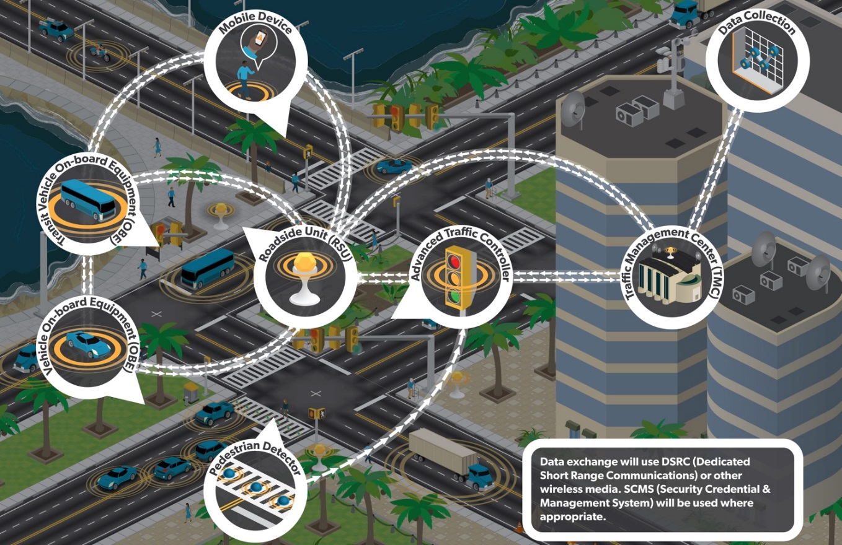
Connected Vehicle Environment
Vehicle to Infrastructure
Vehicle to Vehicle
Pedestrian to Vehicle
Pedestrian to Infrastructure

Slide 10
Connected Vehicle Messages
Broadcast by Vehicle
BSM (Basic Safety Message) - 10 messages per second
Vehicle position, speed, heading, acceleration, braking status, etc.
Broadcast by Infrastructure
SPaT – Signal Phase and Timing
MAP – Digital Map of the Intersection
Intersection Specific Messages - Weather conditions, incident warnings, etc.
Priority Requests
SRM – Signal Request Message
SSM – Signal Status Message

Slide 11
System Simulation – Freight Signal Priority
Simulation Resolution: 10 Real Time steps/Simulation Second
Normal Traffic Actuated Signal System
Trucks enters the network at 00:01:50 (Simulation Time). And starts sending signal request messages.
Before truck reaches the intersection, phases 4 and 8 are “forced off” after their Gmin, to give priority to Truck.
Observe Gmax counter for phases 4 and 8 at 00:02:03 (Simulation time)
The controller resumes the normal operations after the truck leaves.
Phase termination Criteria for 4 & 8: Force Off
1
6
3
8
7
4
5
2

Slide 12
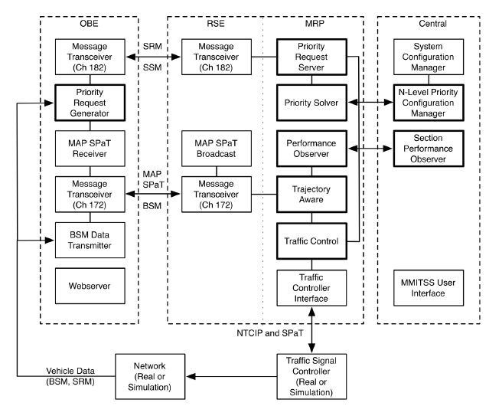
MMITSS Software Architecture

Slide 13
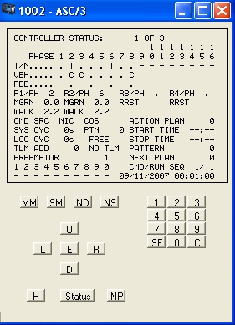
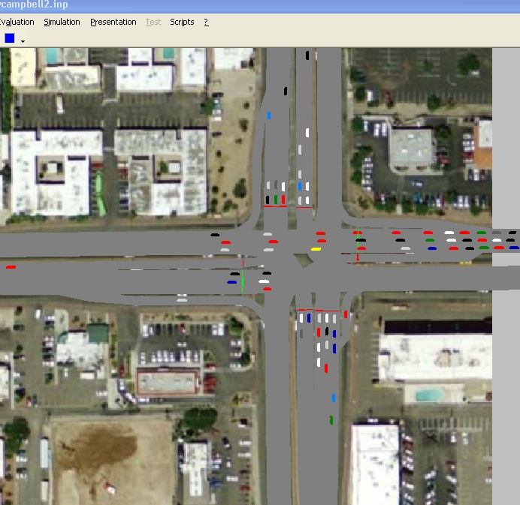
Simulation Platform Architecture
MMITSS
Signal Controller
SIL/CID
Ethernet - NTCIP 1202
VISSIM
In-Vehicle Display
(HIL)
OBE
#1
RSE
#n
OBE
#2
RSE
#n
driverModel.dll
OBE
Distributor
RSE
#n
OBE
#m
Ethernet or
DSRC (5.9 GHz)
[SAE J2735]
GID#n
VISSIM x-y plane to GPS (WGS - 84)
Vehicle Position Mapping
GID#n
GID#n

Slide 14
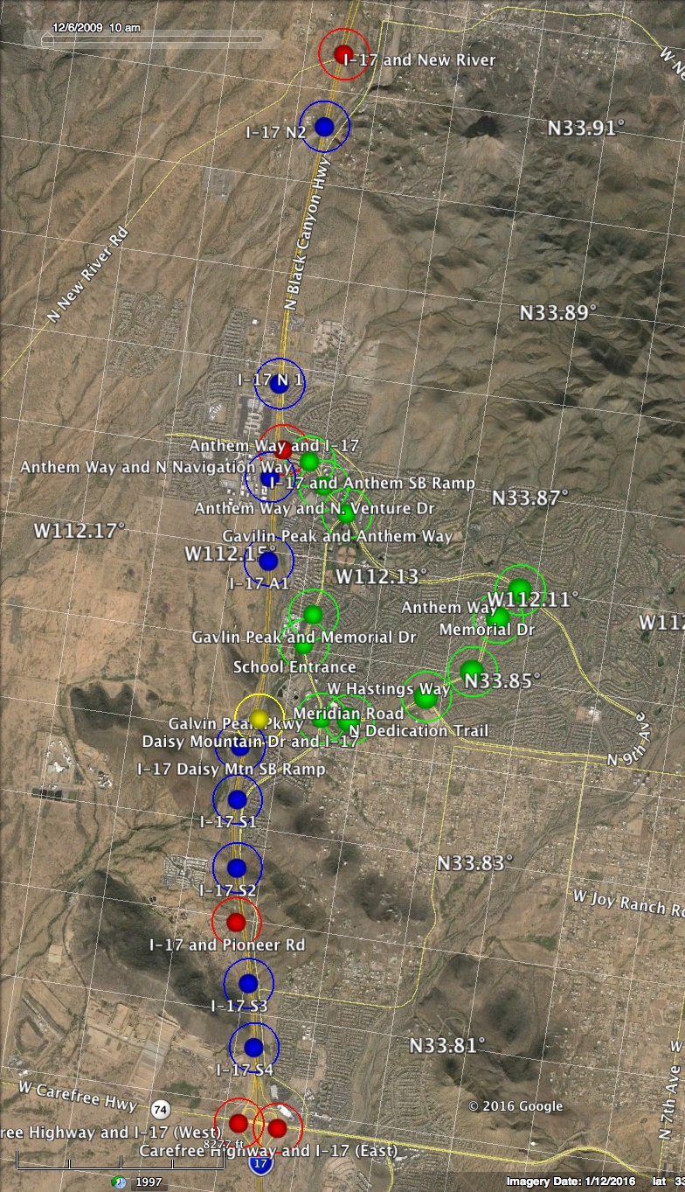
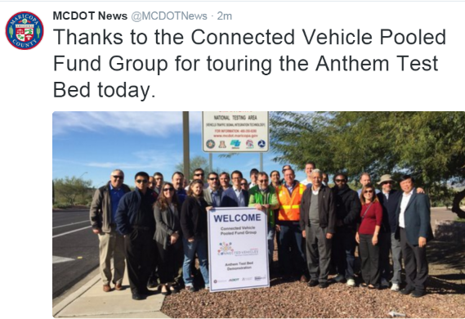
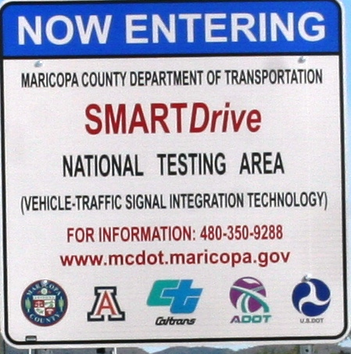
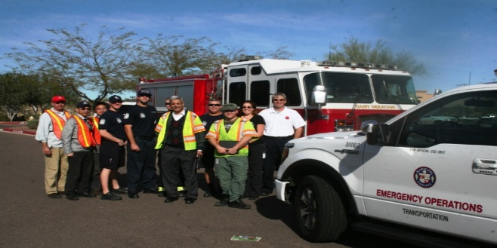
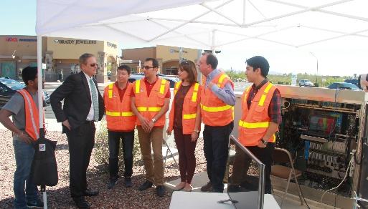
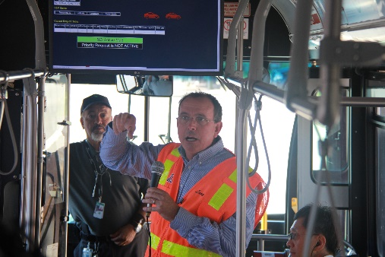
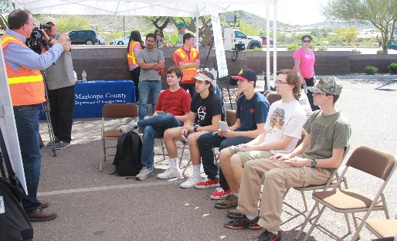
Arizona Connected Vehicle Test Bed
DSRC Installations:
11 Signalized Intersection
6 Freeway Interchanges¹
Freeway Locations¹
Approx. 25,000 Residents
Approx. 10,000 Vehicles
¹ 2017 Expansion Project (ADOT)

Slide 15


